Slide 1
Microsoft Data Analysis

Slide 2

Microsoft Data Analysis
See how to make a movie for Microsoft taking into account the budget, the type of movie, and how the general audience will receive the movie.
We will then analyze the given data sets and explore what are the ultimate avenues to take.

Slide 3
The presentation includes:
What are the practices to produce a box office movie hit.
What Data sets from IMDB, Rotten Tomatoes, Box Office Mojo are used
Methods: Pandas, SeaBorn, ect
What are the results in our findings.
What are some directions to take.

Slide 4

What type of films to create?
The film industry has a lot of pitfalls. Particularly those that involve money. To guide your decisions into this perilous industry we can answer a few basic questions:
How do we know how much is too much and just the right amount to budget.
How does the general public receive the movies?
What are the major traits per movie that they should follow?

Slide 5



Film Data
Data used was from
IMDB
Rotten Tomatoes
Box Office Mojo
They supplied us with a glance at how much money a movie has made domestically, a glance at the production value, and finally a rating.

Slide 6
Methods used for the Data
Pandas to split up comma separated values (CSV) to a data frames, and clean them.
Math, numpy to find some statistical elements within the data.
Seaborn and Matplotlib to plot the data into some graphs

Slide 7
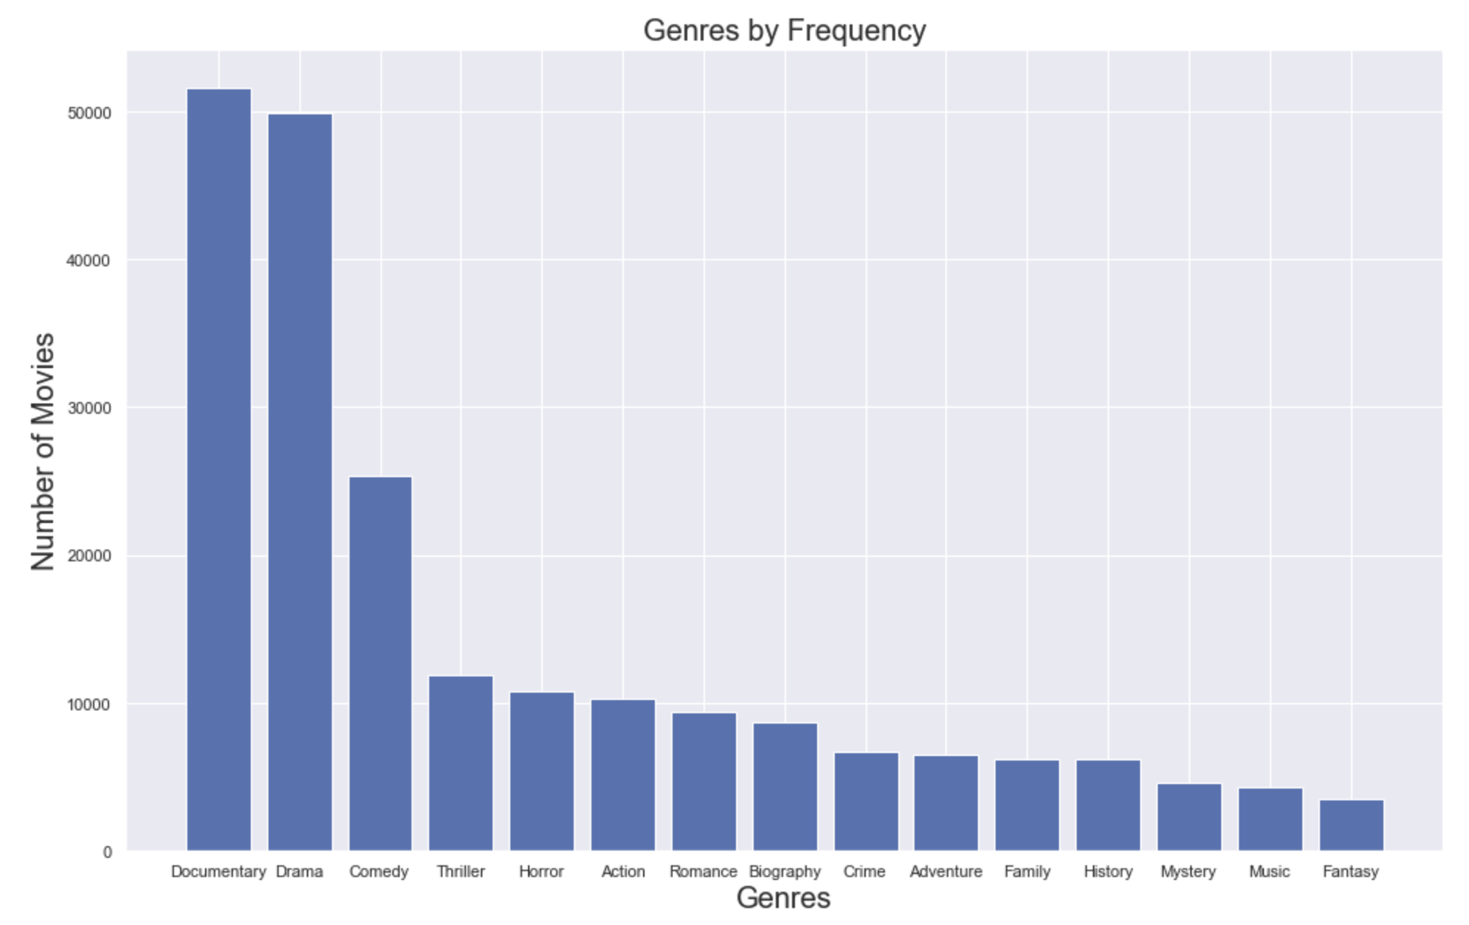

Slide 8
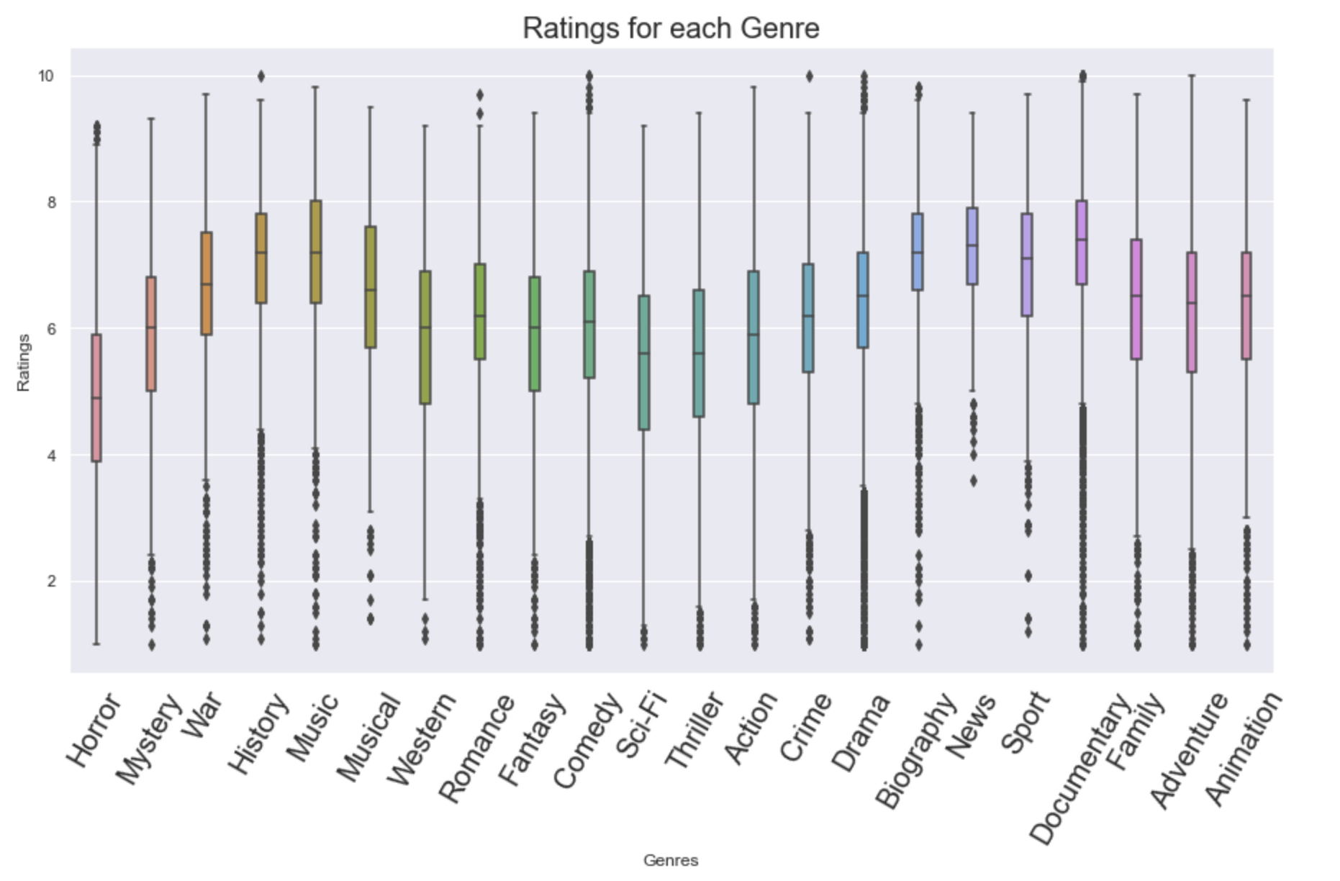

Slide 9
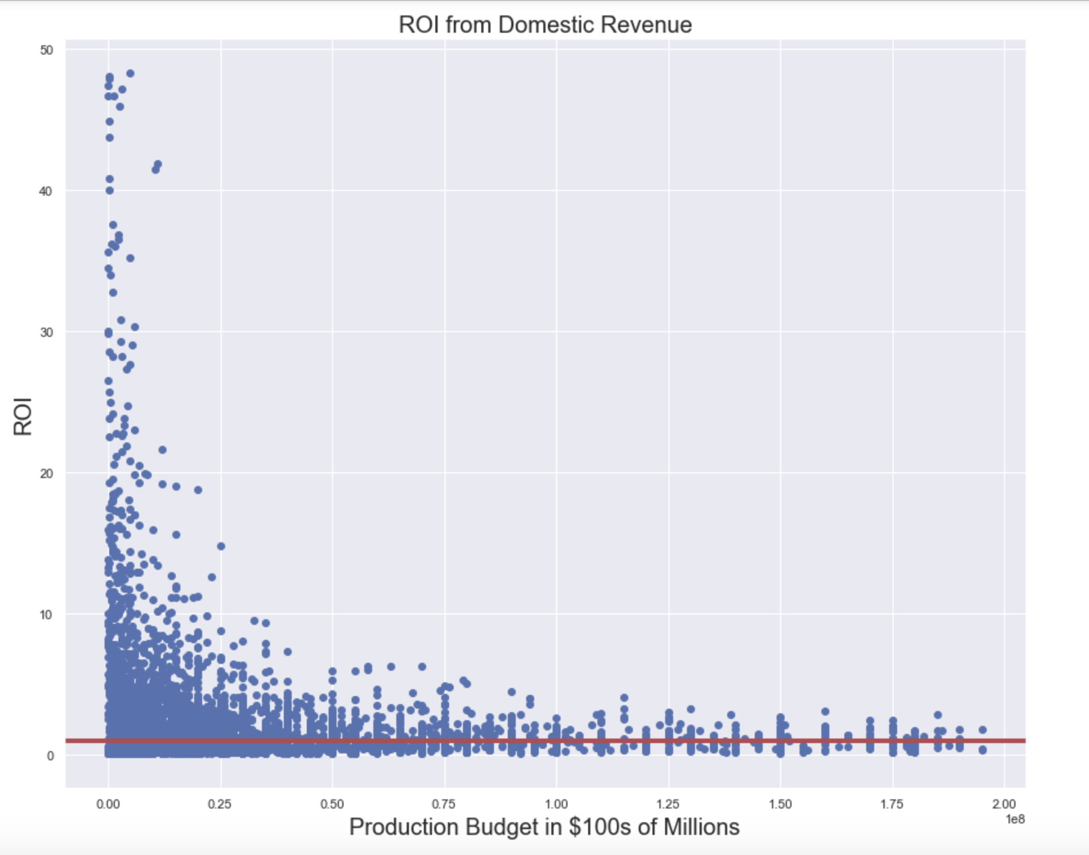

Slide 10
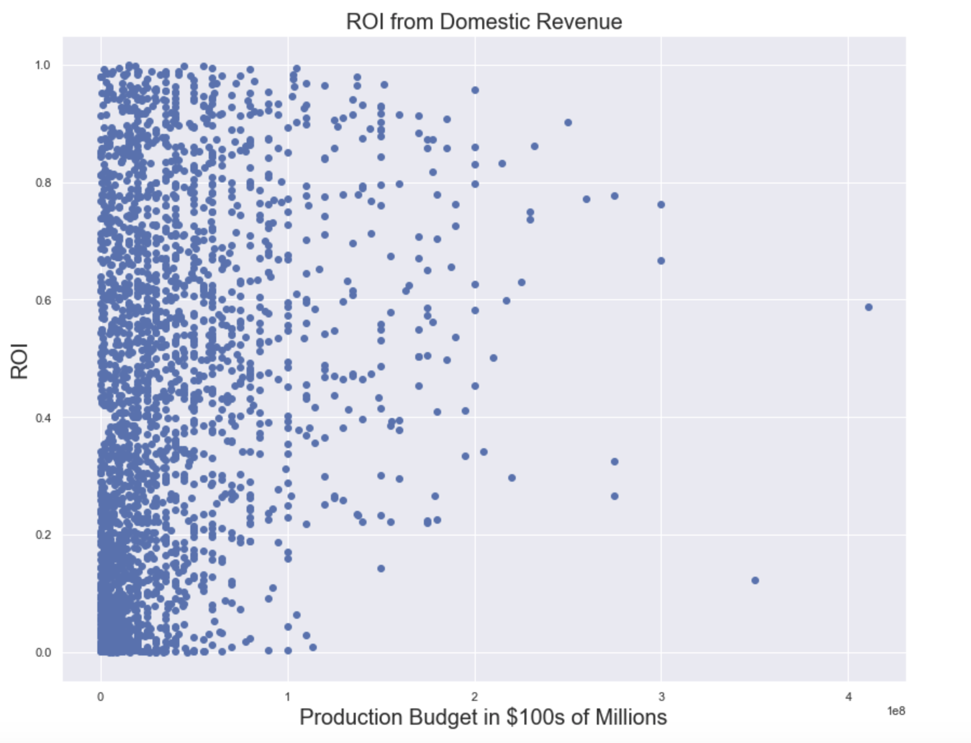

Slide 11

What are the results?
We have found that the main movies have elements that include documentary, drama, and comedy. Focus on these elements in future movie productions.
We were also shown how much a movie is rated by average, and saw how much an impact that movie goes to general audiences.
Also we discovered what is the median amount of money is required for a production and what are our best chances to making a hit movie.

Slide 12
Conclusions
The movie should have a few elements of Drama, Comedy, or Documentary.
We saw which movies are generally taken by the public as favorable. What did the masses tell us about the movie.
Movies that have a much higher budget, are not really given the chance to make back their money.

Slide 13
Thank You!
Email: Garcia.i.joe88@email.com
GitHub: @Foxxenn
LinkedIn: linkedin.com/in/joe-g-84633239/

